Slide 1

Security in an engineering context
Hugh Boyes CEng FIET
Bodvoc Ltd

Slide 3
Our infrastructure is a target

Slide 4
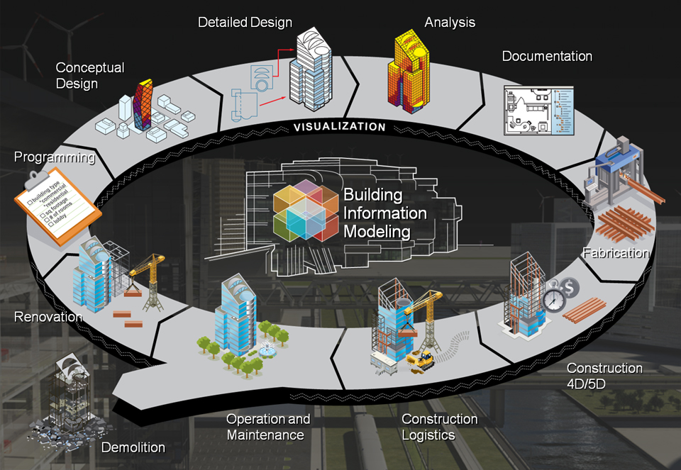
BIM

Slide 5
Sector-to-sector connections & dependence

Slide 6
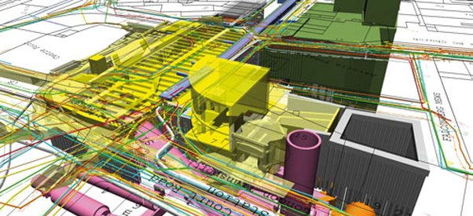
Digital planning of complex infrastructure

Slide 7

Smart Cities and
Digital Twins

Slide 8
Generic asset lifecycle
Conception
Pre-implementation
Implementation
Operation
Disposal

Slide 9
Managing security over
the asset(s) lifecycle

Slide 10
Information management vs Cyber security

Slide 11
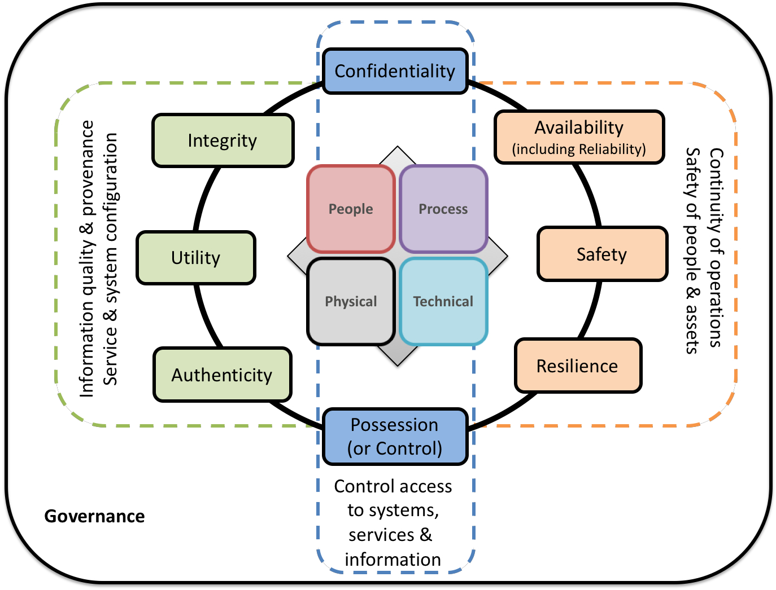
Holistic Approach to Security
Information
© 2019, Bodvoc Ltd

Slide 12
Asset-based risk management approach

Slide 13
Information management vs Cyber security
Covers the information lifecycle.
Involves people and processes
Lifecycle should be supported by appropriate measures to assure and maintain the quality of the organization’s data and information.
Covers the system lifecycle.
Often focussed on technology and physical access
System should maintain data and information integrity, i.e., prevent unauthorized changes, it does not assure the quality of the data and information.
Both require governance, strategic management and clear policies

Slide 14
Engineering Council Guidance on Security
1. Adopt a security-minded approach to your professional and personal life
2. Apply responsible judgement and take a leadership role
3. Comply with legislation and codes, understand their intent and be prepared to seek further improvements
4. Ensure good security-minded communications
5. Understand, comply with and seek to improve lasting systems for security governance
6. Contribute to public and professional awareness of security
Key Principles

Slide 15
Holistic security thinking to protect the digital and physical built environments
Hugh Boyes CEng FIET
Bodvoc Ltd

